Slide 1
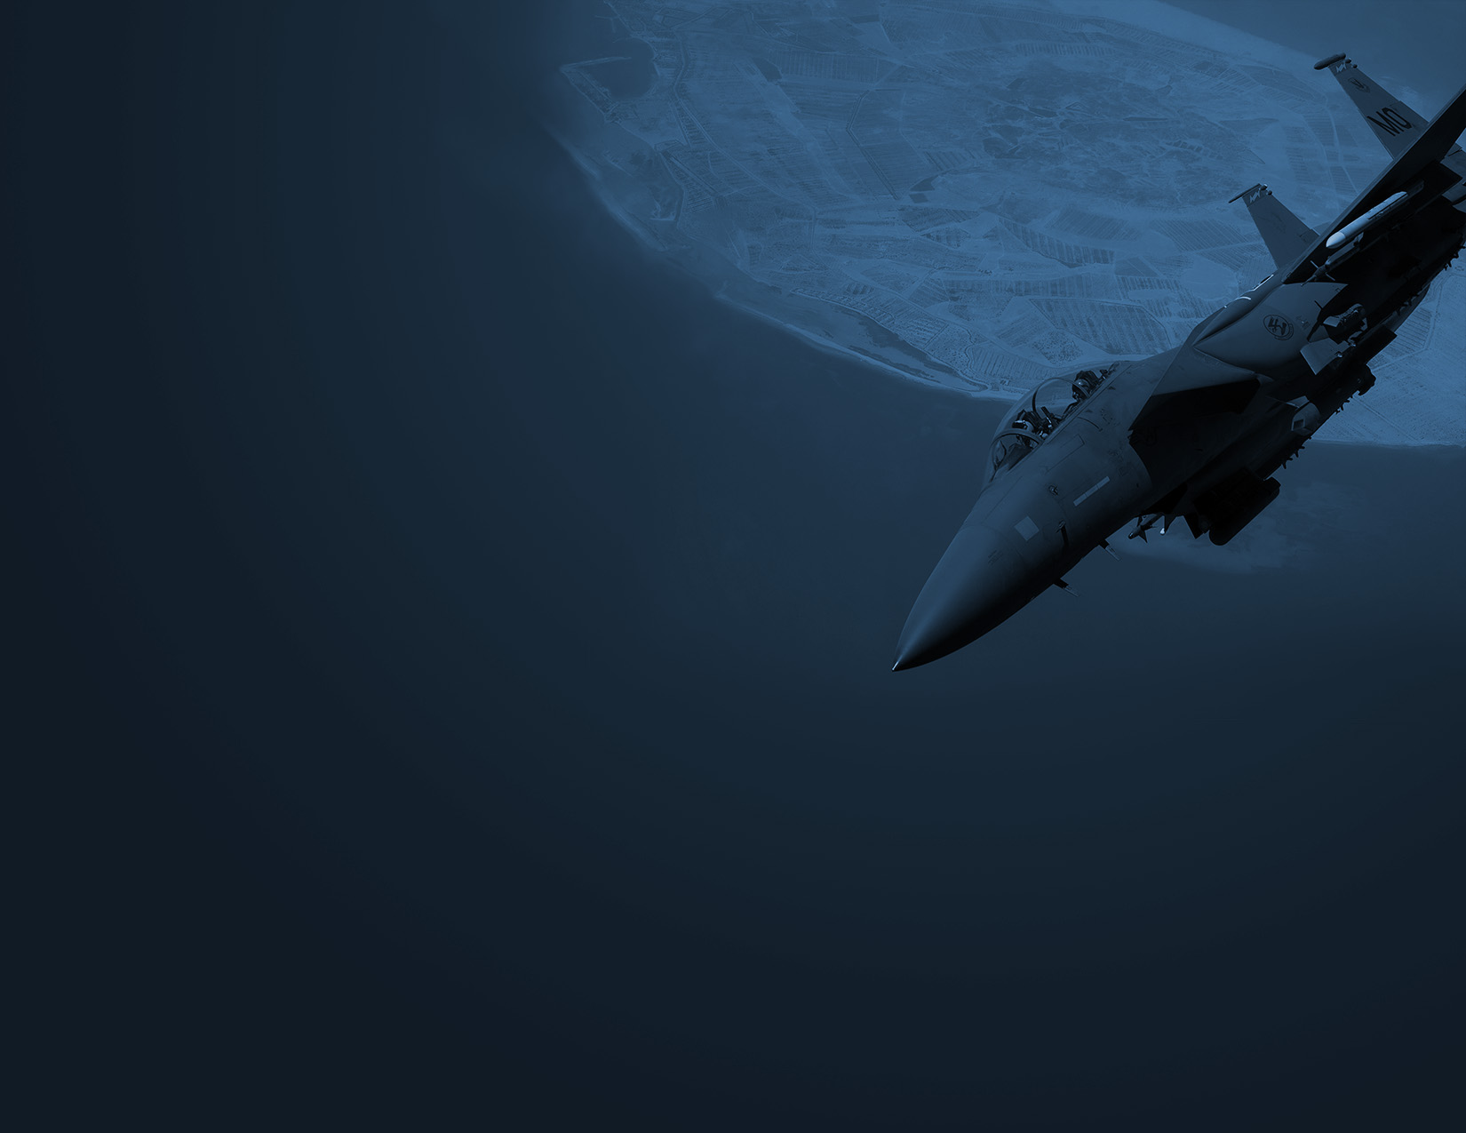
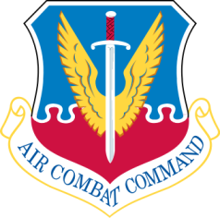

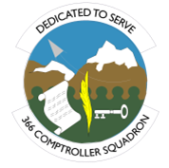
MOUNTAIN HOME
AIR FORCE BASE
The 366th Fighter Wing‘s mission is to prepare mission ready Gunfighters to fight and win today's war and the next.
The wing accomplishes the mission through four subordinate Groups, comprised of 3,452 Active Duty Airmen who fly, maintain or support 47 F-15E Strike Eagle aircraft at the 389th and 391st Fighter Squadrons. An additional 12 F-15SG Strike Eagles belong to the Republic of Singapore's 428th Fighter Squadron, which operates here as a mission partner under the Peace Carvin V program. Mountain Home's Gunfighters stand ready to deploy at a moment's notice to meet the expeditionary needs of Air Combat Command, achieving the Wing's vision to be ACC's premier wing; a cohesive team enhancing our combat capability while building upon our legacy of innovative Gunfighter excellence!
Mountain Home
Air Force Base
Home of the:
366th Fighter Wing
FY2016 Economic Impact Statement
Produced by the
366th Comptroller Squadron
MOUNTAIN HOME
AIR FORCE BASE
Economic Impact Statement
Fiscal Year 2016
For more information, Contact: 366th Comptroller Squadron
366 Gunfighter Ave, Ste 282
Mountain Home AFB, ID 83648
(208) 828-2677

Slide 2

FY16 Economic Impact:
$ 356 Million
Local Contract Expenditures
Construction
O&M Construction $9,006K Non-Appropriated Fund 1,022K
Military Construction 0K
Service Contracts
O&M 1,500K
Medical 4,005K
Non-Appropriated Fund 21K
Materials/Equip/Supply Procurement
Health & TriCare 18,392K
Education (TA & Impact Aid) 2,478K
Temporary Duty Travel 2,809K
Commissary 1,500K
Non-Appropriated Fund 814K
Base Exchange 369K
Total Expenditures $41,916K
Economic Impact
Total Payroll $227,163K
Contract Expenditures 15,554K
Value of Job Creation 113,528K
Total Economic Impact $356M
Personnel
Active Duty Military 3,452
AF Reserve/Air National Guard 160
Total Military 3,612
Appropriated Fund Civilians 464
Contract Civilians 299
Non-Appropriated Fund Civilians 183
Base Exchange 113
Private Businesses 15
Total Civilians 1,074
Total Dependents 4,507
Total Personnel 9,193
Military Pay
Active Duty Military $175,813K
AF Reserve/ANG 8,292K
Republic of Singapore 6,640K
Total Military Pay $190,745K
Civilian Pay
Appropriated Fund $31,681K
Non-Appropriated Fund 2,743K
Base Exchange 1,546K
Private Businesses 448K
Total Civilian Pay $36,418K
Job Creation
Total Number of Jobs Created 2,431
Avg Annual Salary of Jobs Created $46.7K
Estimated Annual Dollar
Value of Jobs Created $113,528K

